Slide 1
CHAPTER 7
LARGE AND FAST: EXPLOITING MEMORY HIERARCHY
Topics to be covered
  Principle of locality
  Memory hierarchy
  Cache concepts and cache organization
  Virtual memory concepts

Slide 2
PRINCIPLE OF LOCALITY
Principle of Locality states that programs access a relatively small portion of their addresses at any instant in time. It creates the illusion of a large memory that we can access as fast as a very small memory.
Two types of locality inherent in programs are:
  Temporal locality: Locality in time
If an item is referenced, it will tend to be referenced again soon.
Example: most programs contains loops, so instructions and data are likely to be accessed repeatedly, showing high amounts of temporal locality.
  Spatial locality: Locality in space
If an item is referenced, items whose addresses are close by will tend to be referenced soon.
Example: access to elements of arrays naturally have high degrees of spatial locality.
The principle of locality allows the implementation of
memory hierarchy.

Slide 3
MEMORY HIERARCHY
Consists of multiple levels of memory with different speeds and sizes.
Goal is to provide the user with much memory at a low cost, while providing access at the speed offered by the fastest memory.

Slide 4
MEMORY HIERARCHY (Continued)
CPU
Speed Size Cost/bit Implemented Using
Fastest Smallest Highest SRAM
Memory
DRAM
Memory
Slowest Biggest Lowest Magnetic Memory Disk
Memory hierarchy in a computer
Memory hierarchy consists of multiple levels but data is copied between only two adjacent levels at a time.
Upper level
Lower level

Slide 5
CACHE MEMORY
Cache represents the level of memory hierarchy between the main memory and the CPU.
→ upper level of the memory
Terms associated with cache
Hit: The item/data requested by the processor is found in some block in the cache.
Miss: The item requested by the processor is not found in the
cache.

Slide 6
Terms associated with cache (Continued)
Hit rate: The fraction of the memory access found in the cache. Used as a measure of performance of the cache.
Hit rate = (Number of hits) / Number of access
= (Number of hits) / (# hits + # misses)
Miss rate: The fraction of memory access not found in cache.
Miss rate = 1.0 - Hit rate

Slide 7
Terms associated with cache (Continued)
Hit time: Time to access the cache memory which
Includes the time needed to determine whether the access is a hit or miss.
Miss penalty:
Time to replace a cache block with the corresponding block from the lower level+ the time to deliver this block to the processor

Slide 8
Cache Organizations
Three types of cache organizations available
  Direct-mapped cache
  Set associative cache
  Fully associative cache

Slide 9
DIRECT MAPPED CACHE
Each main memory block is directly mapped to exactly one location in the
cache. (It is assumed for right now that 1 block = 1word)
For each block in the main memory, a corresponding cache
location is assigned based on the address of the block in the main
memory.
Mapping used in a direct-mapped cache:
Cache index = (Memory block address) modulo (Number of blocks in the cache)

Slide 10
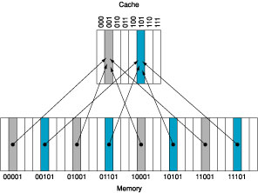
Example of a Direct-Mapped Cache
Figure 7.5 A direct-mapped cache of 8 blocks

Slide 11
Accessing a Cache Location and
Identifying a Hit
We need to know
  Whether a cache block has valid information
  - done using valid bit
  and
  Whether the cache block corresponds to the requested word
  - done using tags

Slide 12
CONTENTS OF A CACHE MEMORY BLOCK
A cache memory block consists of the data bits, tag bits and
a valid (V)bit.
The index of a cache block and the tag contents of that block uniquely specify the memory address of the word contained in the cache block.
V bit is set only if the cache block has valid information.
Cache V Tag Data
index

Slide 13
CACHE AND MAIN MEMORY STRUCTURE
Cache Memory
index V Tag Block address Data
0 0
1 1
2 Block (K words)
K-1
Block
length
(K words)
Word
length

Slide 14
CACHE CONCEPT
CPU
Word transfer
Cache
Block transfer
Main Memory

Slide 15
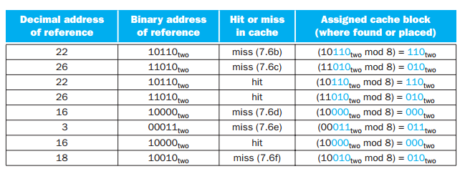
A Cache Example
Q. The series of memory address references given as word addresses are 22, 26, 22, 26, 16, 3, 16, and 18. Assume a direct-mapped cache with 8 one-word blocks that is initially empty. Label each reference in the list as a hit or miss and show the contents of the cache after each reference.
Answer:

Slide 16
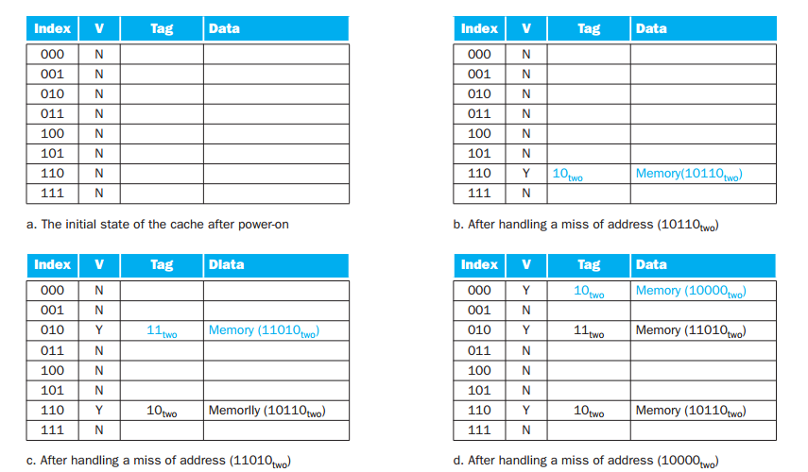
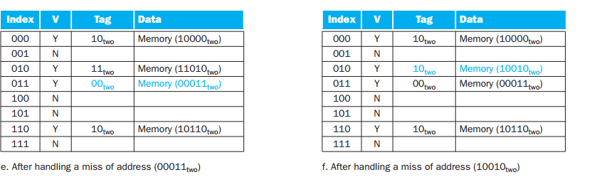

Slide 17
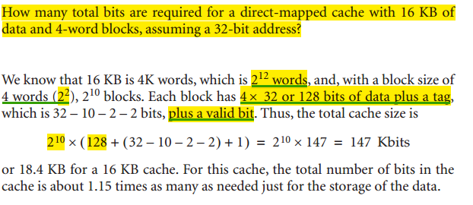
Cache example (2)
If each instruction 2^n blocks,
Each block contains 2^m words
So, tag field size = 32 – (n+m+2)
Total number of bits in a direct mapped cache,
= 2^n *(block size + tag size + valid field size )

Slide 18
HANDLING CACHE MISSES FOR INSTRUCTIONS
  Decrement PC by 4
  Fetch the block containing the missed instruction from the main memory
  Write the block into the cache
        Write the instruction block into the data portion of the referenced cache block
        Copy the upper bits of the referenced memory address into the tag field of the cache memory
        Turn the valid (V) bit on
  Restart the fetch cycle - this will refetch the instruction, this time finding it in cache

Slide 19
HANDLING CACHE MISSES FOR DATA
  Read the block containing the missed data from the main memory
  Write the block into the cache
        Write the data into the data portion of the referenced cache block
        Copy the upper bits of the referenced memory address into the tag field of the cache memory
        Turn the valid (V) bit on
    The requested word may be forwarded immediately to the processor as the block is being updated
or
    The requested word may be delayed until the entire block has been stored in the cache

Slide 20
CHOOSING WHICH BLOCK TO REPLACE
Direct-mapped Cache
When a miss occurs, the requested block can go in exactly one position. So the block occupying that position must be replaced.
Set associative or fully associative Cache
When a miss occurs we have a choice of where to place the requested block, and therefore a choice of which block to replace.
  Set associative cache:
  All the blocks in the selected set are candidates for replacement.
  Fully associative cache:
  All blocks in the cache are candidates for replacement.

Slide 21
VIRTUAL MEMORY
Virtual memory permits each process to use the main memory as if it were the only user, and to extend the apparent size of accessible memory beyond its actual physical size.(Advantages)
Virtual memory does not exist in physical memory. The virtual address generated by the CPU is translated into a physical address, which in turn can be used to access the main memory. The process of translating the virtual address into a physical address is called memory mapping or address translation.
Page: A virtual memory block
Page fault: A virtual memory miss
Figure 7.20 The virtual addressed memory with pages mapped to the main memory
Figure7.21 Mapping from a virtual to a physical address

Slide 22
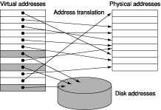
Figure 7.19 The virtual addressed memory with pages mapped to the main memory

Slide 23
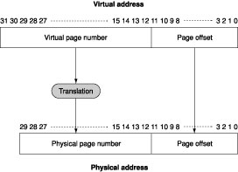
Figure7.20 Mapping from a virtual to a physical address

Slide 24
PLACING A PAGE AND FINDING IT AGAIN
Operating system must maintain a page table.
Page Table
  Maps virtual pages to physical pages or else to locations in the secondary memory
  Resides in memory
  Indexed with the page number from the virtual address
Each program has its own page table, which maps the virtual address
space of that program to main memory.
No tags are required in the page table because the page table contains a
mapping for every possible virtual page.
Page table register
  Indicates the location of the page table in the memory
  Points to the start of the page table.

Slide 25
PAGE FAULTS
If the valid bit for a virtual page is off, a page fault occurs.
  Operating system is given control at this point (exception mechanism)
  OS finds the page in the next level of the hierarchy (magnetic disc for example)
  OS decide where to place the requested page in main memory
  OS also creates a data structure that tracks which processes and which virtual addresses use each physical page.
  When a page fault occurs, if all the pages in the main memory are in use, the OS has to choose a page to replace. The algorithm usually employed is the LRU replacement algorithm.

Slide 26
WRITES (self)
In a virtual memory system, writes to the disk take hundreds of
thousands of cycles. Hence write-through is impractical. The
strategy employed is called write-back (copy back).
Write-back technique
  Individual writes are accumulated into a page
  When the page is replaced in the memory, it is copied back into the disk.

Slide 27
MAKING ADDRESS TRANSLATION FAST:
THE TRANSLATION-LOOKASIDE BUFFER (TLB)
If a CPU has to access a page table resident in the memory
to translate every memory access, the virtual memory would
have too much overhead. Instead a TLB cache can be used
to implement the page table.
Figure 7.24 TLB acts as a cache for page table references

Slide 28
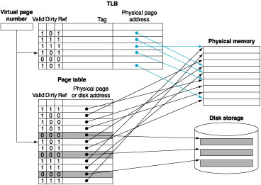
Figure 7.23 TLB acts as a cache for page table references

